Slide 1
Introduction to Wing
A new cloud-oriented programming language
Notes:
Thanks everyone for coming to my talk
This is Introduction to Wing, a new cloud-oriented programming language
The why’s of a new language
Show you what we can unlock with it

Slide 2

I’m Cristian Pallarés Slides & Links
Software Engineer
From Barcelona, Spain
Small contributions to:
Vue
Laravel
Projen
AWS CDK
Working at Wing Cloud
https://github.com/skyrpex
Notes:
Developing software for 10y+
Full stack:
Little C++
JS / TS; Vue / React; CSS / TailwindCSS
PHP / SQL
CDK

Slide 3

Wing Cloud Team
Founded in April’ 22
By Shai Ber & Elad Ben-Israel
Open Source
Slack Community
https://winglang.io
Please, come by :)
Notes:
I know what you’re thinking :) We look like a sect here, but he photo is cute
We mainly do open source
Important stuff is done via RFCs, open to everybody
Many interesting and passionate people in the community

Slide 4
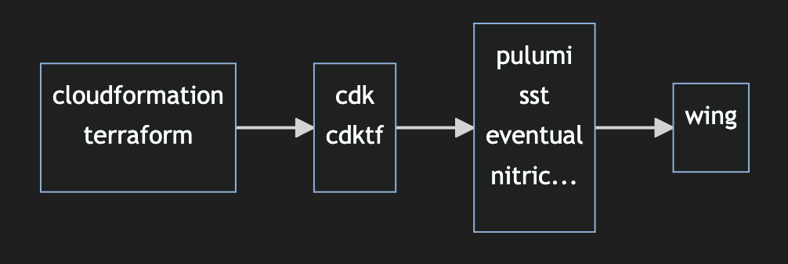
Evolution of IaC & their problems
Notes:
To understand why wing exists, we must first understand the evolution of IaC and the problems they had.

Slide 5
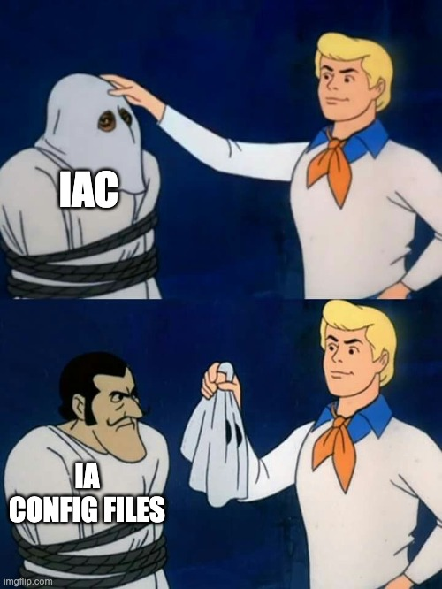
CloudFormation & Terraform
Notes:
CloudFormation & Terraform are the foundation for IaC
But they are not IaC
They are IaConfigFiles

Slide 6
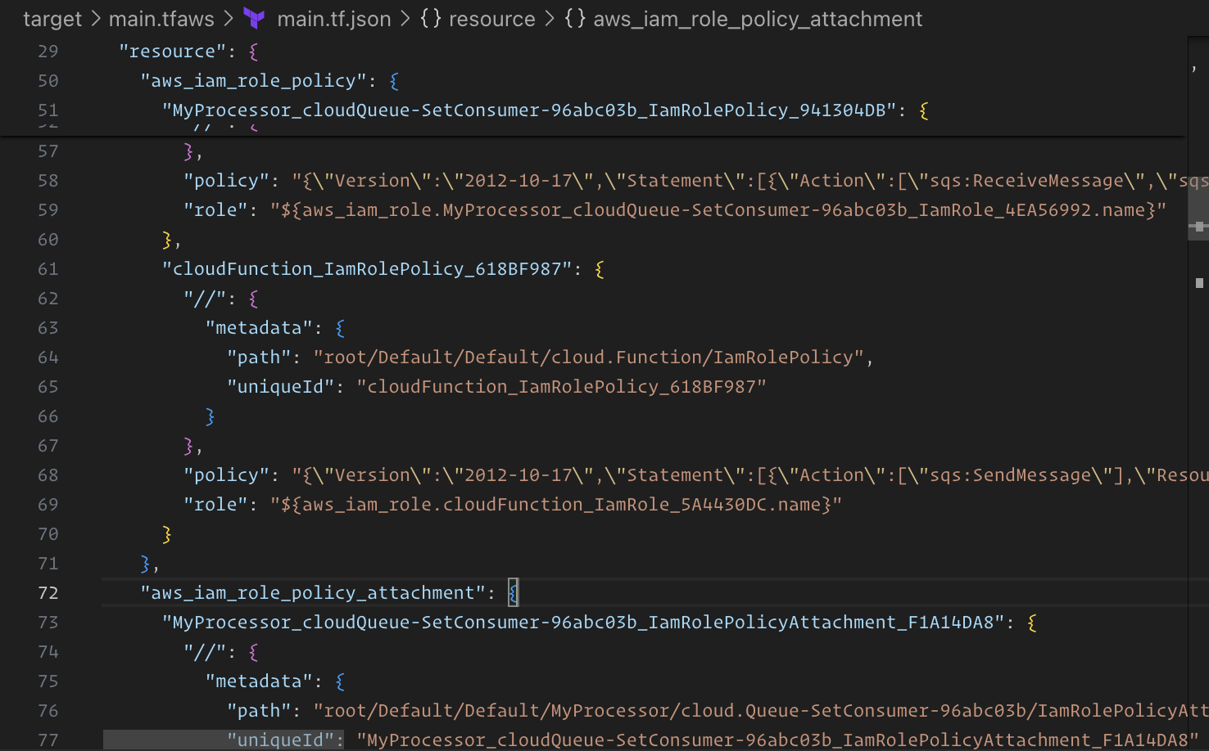
CloudFormation & Terraform
Too low level
Not for humans
Hard to use
Hard to read
Hard to write
Hard to reuse
Notes:
The config files needed to work with these technologies are huge
There’s no aid for the developer when writing these files
They are like the assembly of the cloud: we’re not supposed to write it directly

Slide 7
CDK & CDKTF
TypeScript & others: much better than config files
But there’s still a big gap in DX:
Manual permissions management
Manual environment variables management
No type safety for runtime code *
Slow feedback
Notes:
Many things to do when creating a simple function that puts a file on a bucket:
New Function, New Bucket
Decide an environment variable name to pass the Bucket Name (or ARN? Or URL?) to the Function (ie, BUCKET_NAME)
Assign write permissions to the Function so it can put files in the Bucket
Write the Function code, create a bucket client and use the BUCKET_NAME
Hope you didn’t mistype
No type safety:
You have some type safety (ie, you use the AWS SDK to access a Queue)
But you may have additional constraints (ie, your Queue is only supposed to hold two types of messages, with a specific format)
Can’t ensure this type safety when manually wiring environment variables, SDKs and permissions

Slide 8
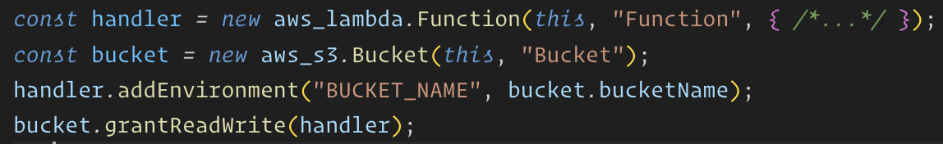
CDK & CDKTF
TypeScript & others: much better than config files
But there’s still a big gap in DX:
Manual permissions management
Manual environment variables management
No type safety for runtime code *
Slow feedback
Notes:
Many things to do when creating a simple function that puts a file on a bucket:
New Function, New Bucket
Decide an environment variable name to pass the Bucket Name (or ARN? Or URL?) to the Function (ie, BUCKET_NAME)
Assign write permissions to the Function so it can put files in the Bucket
Write the Function code, create a bucket client and use the BUCKET_NAME
Hope you didn’t mistype
No type safety:
You have some type safety (ie, you use the AWS SDK to access a Queue)
But you may have additional constraints (ie, your Queue is only supposed to hold two types of messages, with a specific format)
Can’t ensure this type safety when manually wiring environment variables, SDKs and permissions

Slide 9
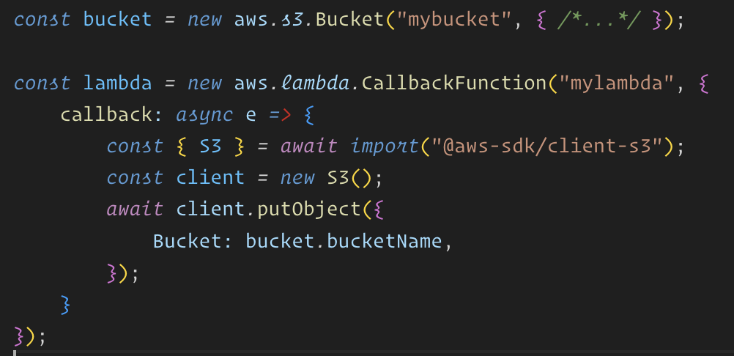
Pulumi
Write code with pulumi.runtime.serializeFunction API
Love it, but has shortcomings
Notes:
Not compatible with ESM
Has trouble capturing many object types
Has trouble capturing classes with inheritance
Has trouble capturing native code
May be better nowadays
Mention cloudy.

Slide 10
SST, Eventual, Nitric, etc…
Very good DX!
But still…
Some are locked to AWS
Some don’t offer a true local experience
Some require writing IAM policies manually
We want more
Notes:
They are amazing, please check them out!
But we want more. We want to have immediate local experience, we don’t want to write least privilege IAM policies by hand.

Slide 11
A “cloud-oriented” programming language
Infrastructure and code in one language
Instant local simulation
Embrace the diversity of the cloud
Familiar and interoperable with your stack
Repository: https://github.com/winglang/wing
Online playground: https://www.winglang.io/play

Slide 12
Future of Wing
Type generics & aliases
Phase inference
Debugging
More & better resource abstractions
Console
Better map view
Live data flow visualization
Traces
And more!
Notes:
I’m a TypeScript developer, and I know that type generics are a must! They skyrocket the DX by providing superb type checking for your application. Think of queues that only allow certain types of messages, or functions that have specific input parameters. The compiler can tell you when you’re doing it wrong
I think Wing will be able to infer the phase of a function in certain cases, saving you keystrokes. Imagine you’re creating a Function and you pass write the handler inline: the compiler knows it has to be an inflight function.

Slide 13
Thank you!
Slides & Links

